Slide 1

课时练习
模块八 第一章 第二节

Slide 2
一、翻译下列词组。
1. 有两个口袋的棉裤 ___________________________
2. 一件如此酷的风衣 ___________________________
3. 一件皮革夹克衫 _______________________
4. 环顾四周 _____________________________
cotton pants with two pockets
such a cool windbreaker
a leather jacket
look around

Slide 3
二、根据语境、音标或所给单词的提示完成句子， 每空一词。
1. The jeans are made in three_____: small, medium and large.
2. Ding Zhen has a very _______/ˈprɪti/, white horse named Pearl.
3. He was a tall, __________/ˈhænsəm/ man who had an air of confidence.
sizes
pretty
handsome

Slide 4
二、根据语境、音标或所给单词的提示完成句子， 每空一词。
4. Eric emptied out all his _______(pocket) but could not find his keys. .
5. The students are busy __________ (prepare) for the coming art festival.
pockets
preparing

Slide 5
三、单项选择。
( )1. —_____shoes does your daughter wear, Madam?
—Size 5.
A. How size B. What size C. How big
B

Slide 6
三、单项选择。
( )2. Xu Yuanchong was ____ a great translator (翻译家) that many people look up to him.
A. so B. such C. quite
B

Slide 7
三、单项选择。
( )3. Seeing the traffic light turn red, the driver stopped his car _____ near the crosswalk.
A. at once B. at first C. at least
A

Slide 8
三、单项选择。
( )4. —How much rent do you ______ for this apartment?
—3,000 yuan a month.
A. cost B. spend C. pay
C

Slide 9
三、单项选择。
( )5. —________________?
—They look nice. I like them.
A. How much are these shoes
B. What do you think of the pants
C. Would you like to buy a pair of shoes
B

Slide 10
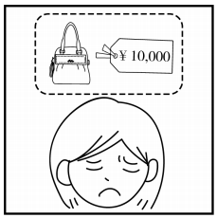
四、看图写话。
1. so … that, afford
The handbag is/was so expensive that the woman can’t/couldn’t afford it.

Slide 11
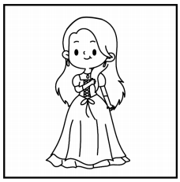
四、看图写话。
2. great, on
The dress looks great on her/the girl.

Slide 12
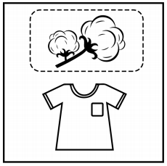
四、看图写话。
3. be made of
The T-shirt is made of cotton.

Slide 13
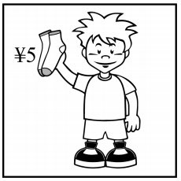
四、看图写话。
4. cost
The socks cost the boy 5 yuan./
This pair of socks cost him five yuan.

Slide 14
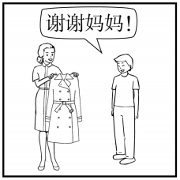
四、看图写话。
5. buy
The mother bought a windbreaker for her son.

Slide 15


